Slide 1

GARUDA POWER
CSR REPORT
CSR IMPACT REPORT 2018–2026
A comprehensive overview of Garuda Power Pvt Ltd's corporate social responsibility
initiatives, community investments, and measurable impact across Eastren Region for the financial years FY 2018–2026.

Slide 2


EXECUTIVE
SUMMARY
Total CSR Investment
Projects Completed
1.52 Crores invested across 6 CSR categories over FY 2018–26 reflecting Garuda Power's sustained commitment to community development and social impact.
Multiple high-impact initiatives executed across two financial years, spanning 6 core categories with verified documentation and measurable outcomes.
Beneficiaries Reached
Thousands of lives positively impacted across health, education, sports, hygiene, infrastructure
and livelihood programmes in targeted communities.

Slide 3
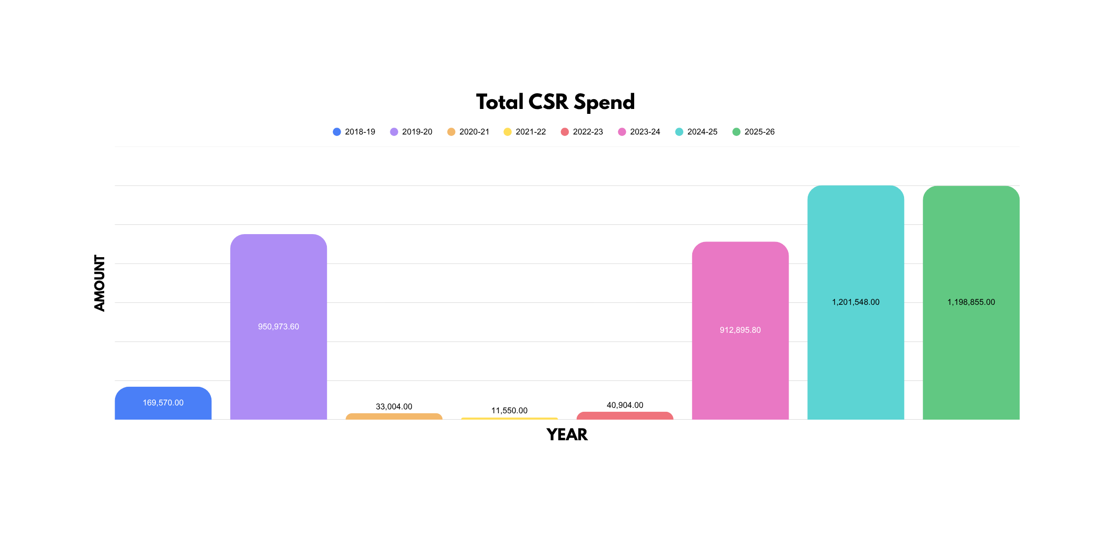
CSR Portfolio
Dashboard

Slide 4
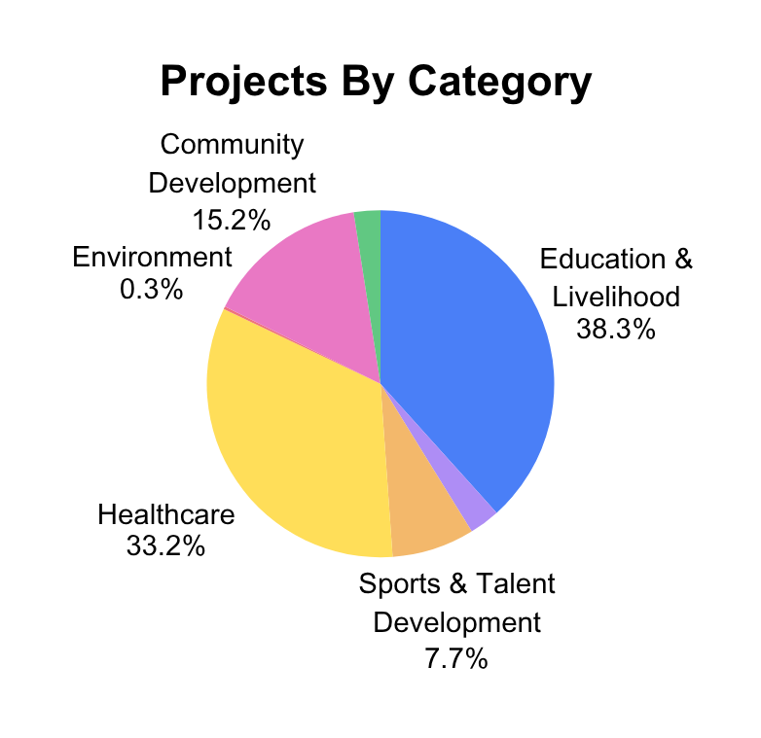
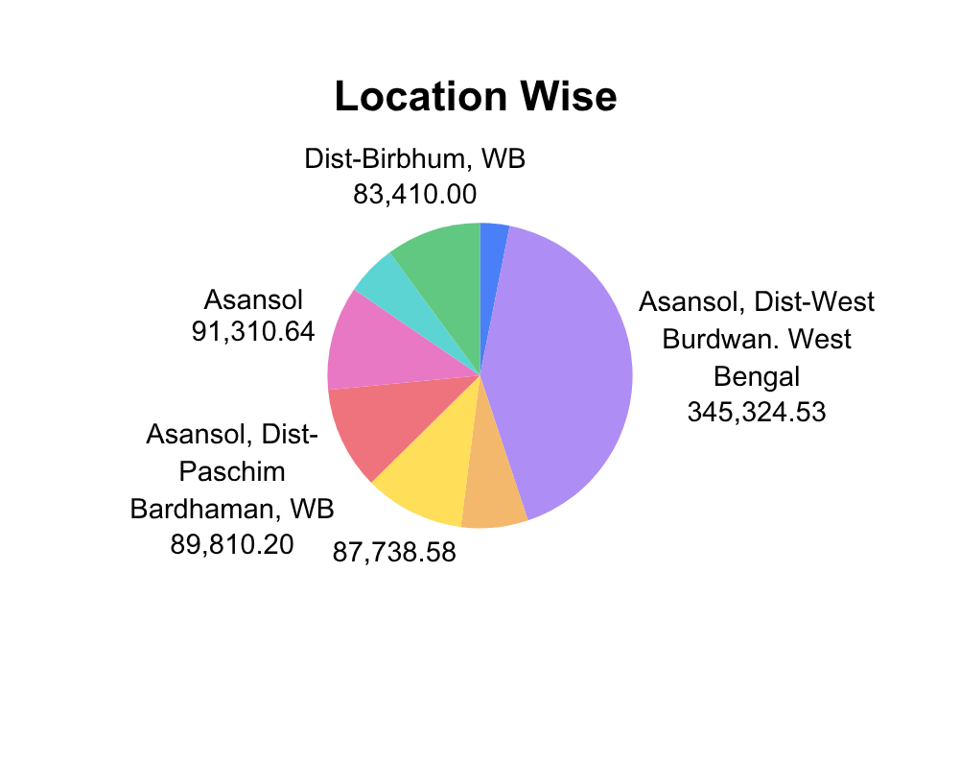
CSR Portfolio
Dashboard

Slide 5
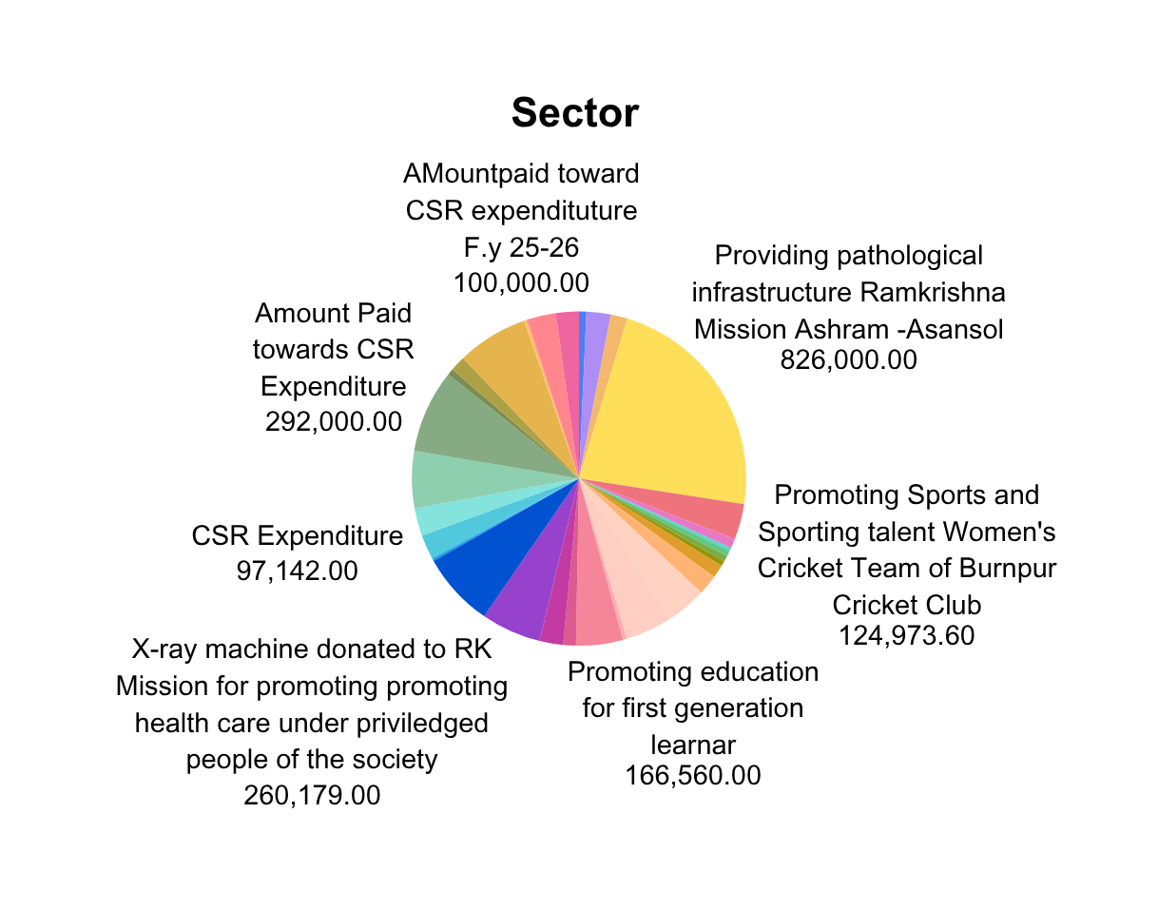
CSR Portfolio
Dashboard

Slide 6
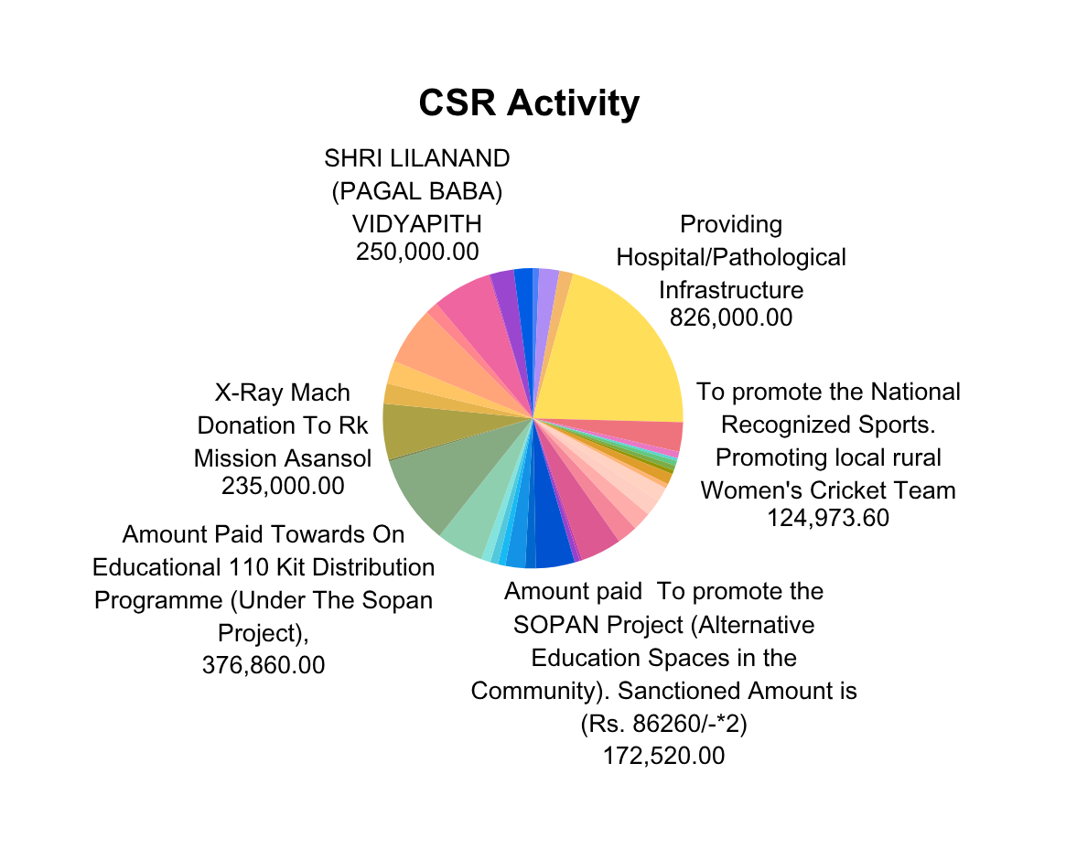
CSR Portfolio
Dashboard

Slide 7


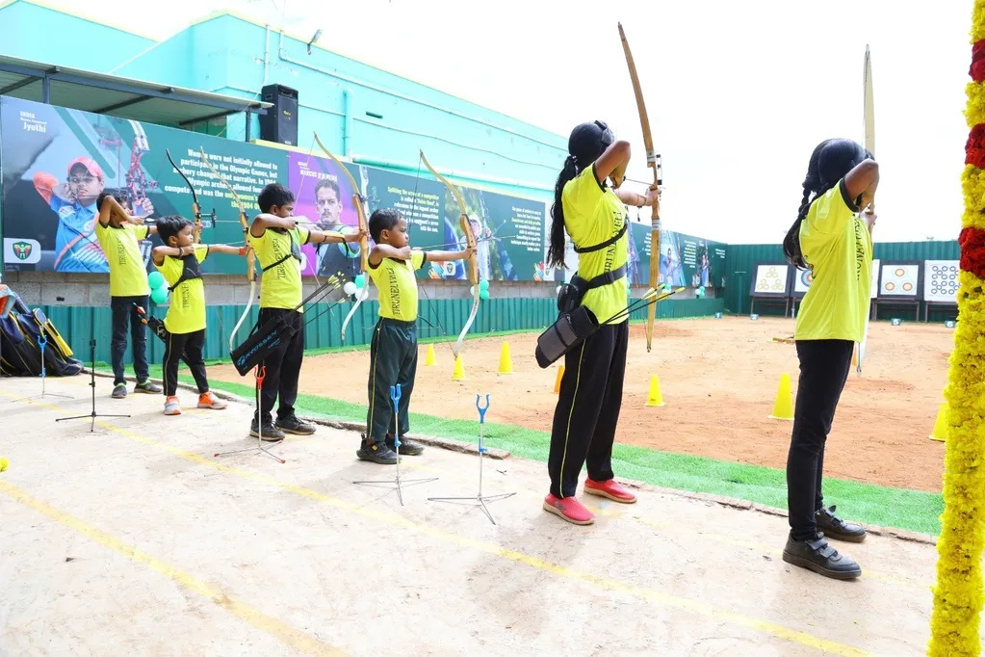
Sports &
Archery
Archery Development
Garuda Power has supported tribal and rural youth through dedicated archery training programmes, providing bows, arrows, coaching and competition exposure to nurture talent in underserved communities across the region.
Sports Infrastructure
Investment in sports infrastructure includes construction of archery ranges, provision of equipment kits and uniforms, and sponsorship of district and state-level competitions to build a pipeline of skilled young athletes.

Slide 8
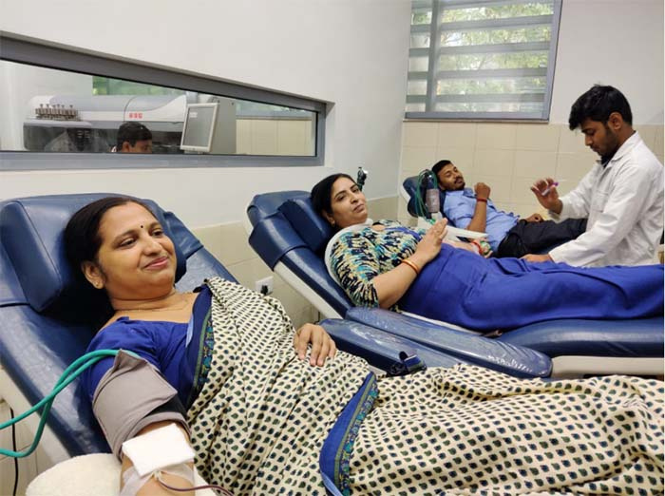

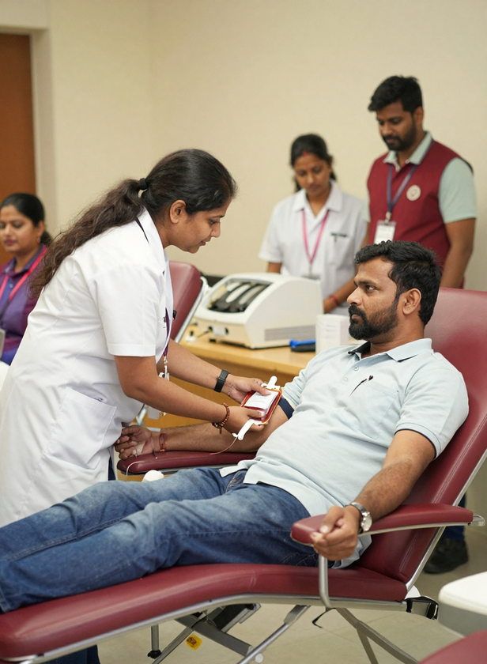
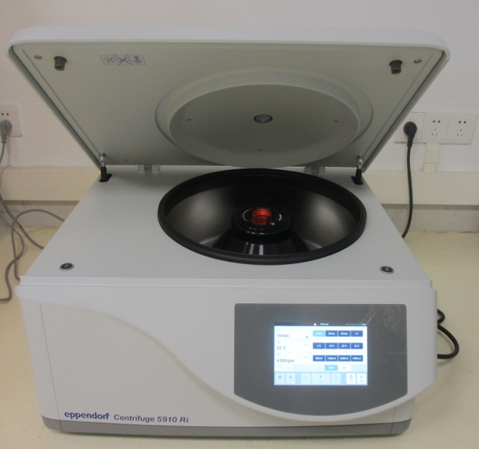
Blood & Health
Spotlight
Health Camps & Outreach
Garuda Power-supported health outreach programs have delivered free medical check-ups, diagnostic screenings, and centrifuge-aided blood processing services to communities in need, improving early detection of diseases and promoting preventive healthcare across grassroots levels.
Blood Donation Drives
Garuda Power has organised and sponsored multiple blood donation camps across tribal and rural communities in India, facilitating voluntary blood donations and ensuring adequate blood supply to regional hospitals and healthcare centres serving underserved populations.

Slide 9
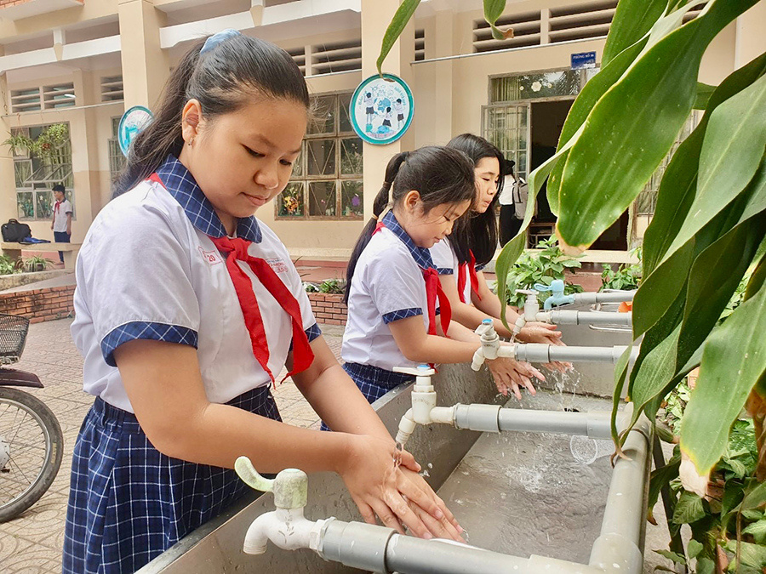
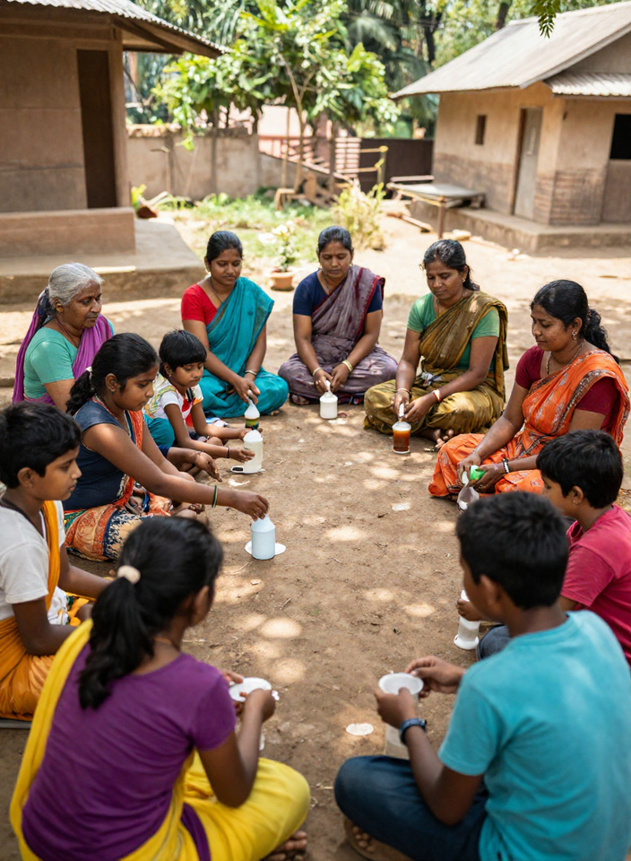
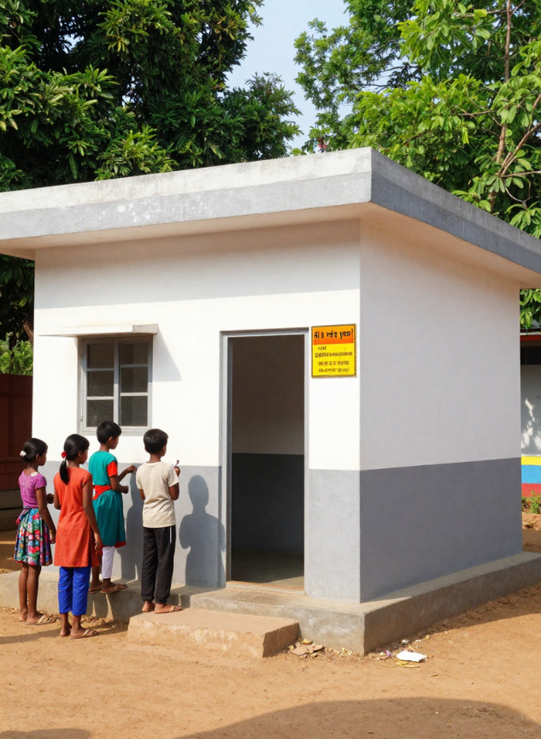
Hygiene &
Toilet Blocks
Spotlight
Toilet Block Construction
Hygiene Awareness
Garuda Power constructed dedicated toilet blocks in rural schools and communities, providing safe, clean sanitation facilities to underserved populations across project areas.
Community hygiene drives educated hundreds of families on sanitation best practices, handwashing, and clean water usage — reducing disease and improving public health outcomes.

Slide 10
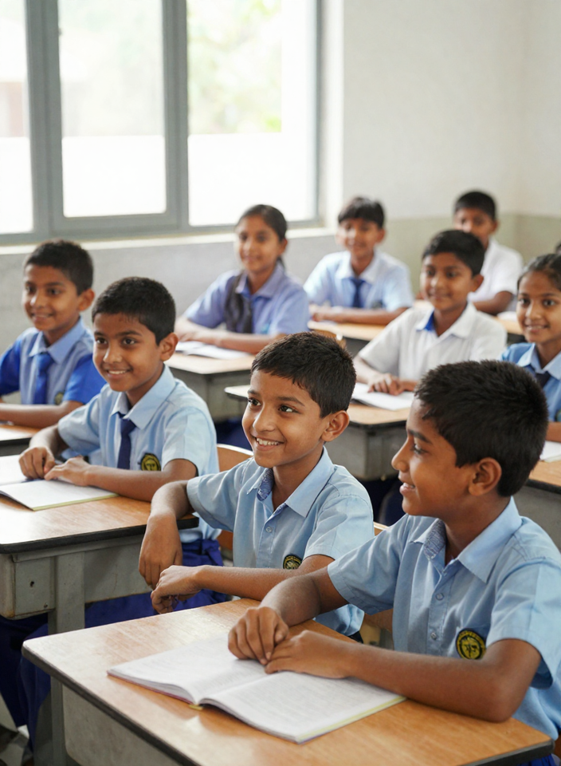
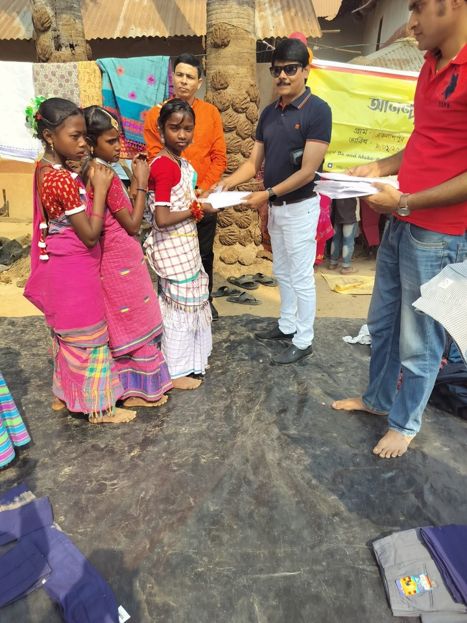
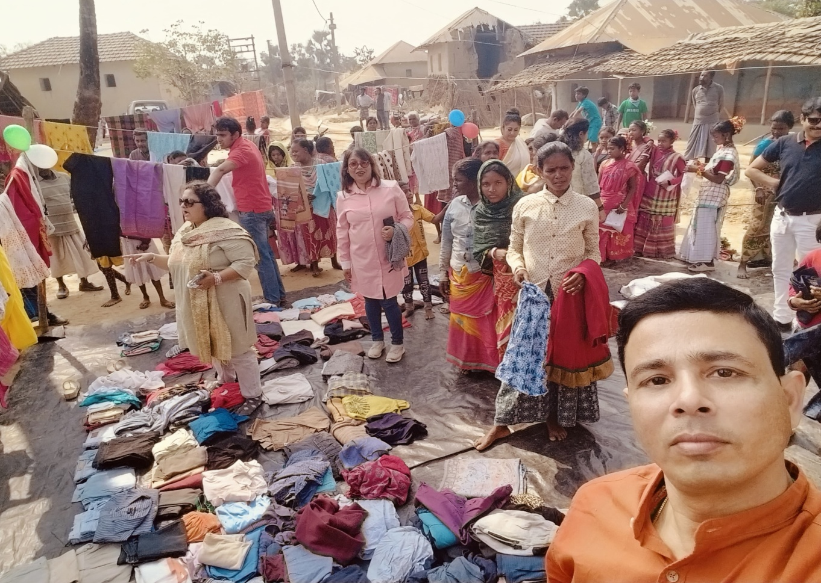
Student
Support
Books & Stationery
Computers & Clothes
Garuda Power has distributed thousands of books, notebooks, and stationery kits to students in government and rural schools, ensuring every child has the tools needed to learn and succeed in the classroom.
Computer labs have been set up in underserved schools and uniform & clothing drives have provided students with dignity and comfort, reducing dropout rates and encouraging consistent school attendance.

Slide 11

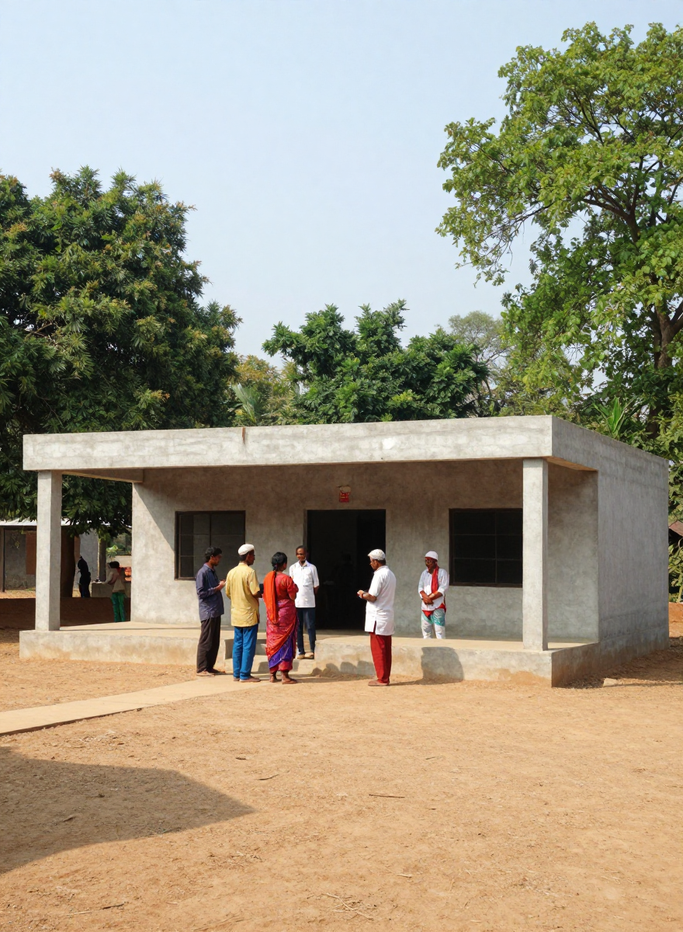
Infrastructure:
Impact Story
Community Facilities
Infrastructure Impact
Garuda Power has funded construction and renovation of community infrastructure across tribal and rural villages — including roads, community halls, water access points, and boundary walls. These assets provide lasting utility and improve daily living standards for thousands of residents.
Infrastructure investments have strengthened village connectivity, enabled access to essential services, and created spaces for community gatherings. Each facility is built to serve long-term needs, reflecting Garuda Power's commitment to sustainable, people-centered development in underserved regions.

Slide 12





Education &
Livelihood.
Skill Development
Livelihood Support
Education Access
Vocational training programmes delivered to youth and women in rural communities, covering trades such as tailoring, electrician work, and computer literacy to enhance employability.
Self-help groups and micro-enterprise initiatives supported across target geographies, enabling sustainable income generation and financial independence for underserved households.
Scholarships, tuition support, and educational material distribution provided to students from low-income families to reduce dropout rates and improve learning outcomes.

Slide 13


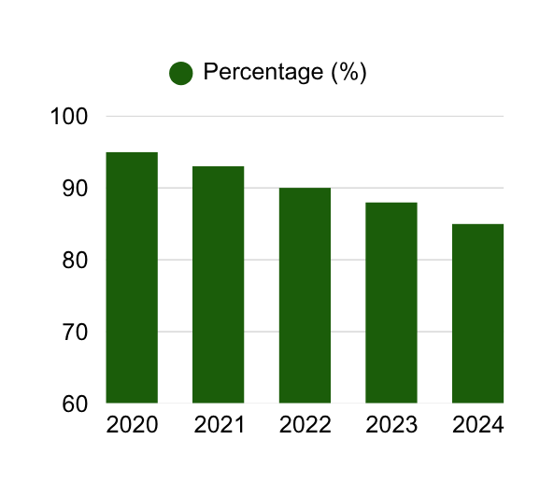
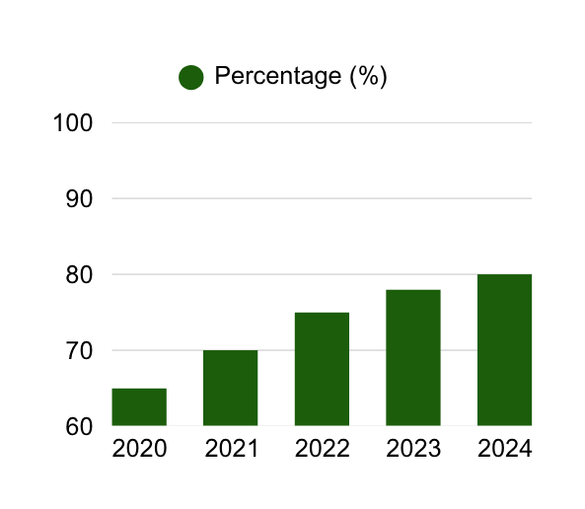
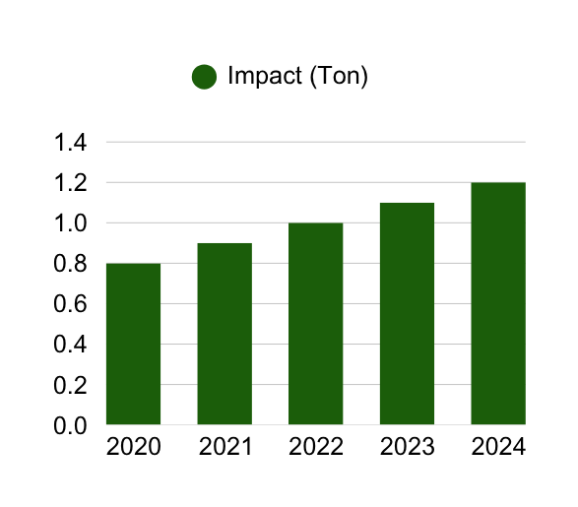
FY 2025–26
Focus Areas.
Expanded Outreach
Spend Targets
New Initiatives

Slide 14




Geographic
Footprint.
States & Districts Reached Across India.
Garuda Power's CSR initiatives span multiple states including Maharashtra, Karnataka, Rajasthan, and Odisha. Over 12 districts have been directly impacted, with beneficiaries spread across both rural villages and urban communities, ensuring inclusive and wide-reaching development across 2023–26.
Rural vs. Urban Distribution & Community Reach.
Approximately 72% of CSR investments are directed toward rural communities, addressing grassroots needs in health, education, and sanitation. The remaining 28% supports urban and peri-urban populations, with implementation partners ensuring last-mile delivery across all geographies.

Slide 15



Implementation &
Partners.
Implementation Framework.
CSR projects are executed through a structured implementation model involving direct disbursement to verified NGO partners and community organisations. Each partner undergoes due diligence, signs MoUs, and submits utilisation certificates, completion reports, and beneficiary registers to ensure accountability and traceability of all CSR expenditure across all six focus categories.
NGO & Field Partners.
Garuda Power works with implementing partners across sports development bodies, health camps, sanitation trusts, educational NGOs, and infrastructure committees. Partner performance is reviewed by the Board CSR Committee annually. Third-party assessments and field visits validate impact, ensuring alignment with Schedule VII of the Companies Act 2013 and MCA CSR-2 filing requirements.

Slide 16
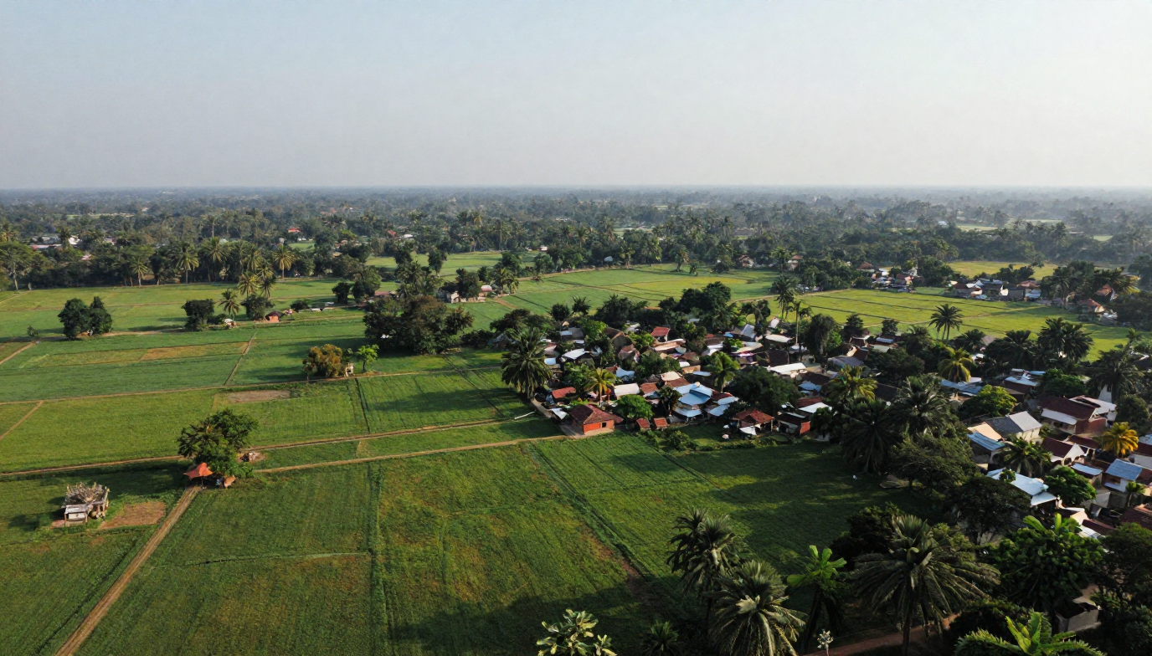
Sports & Archery
Blood Donation & Health
Supporting tribal youth through archery training, sports kits, and tournament participation — building discipline, identity, and opportunity for rural communities in Odisha and Jharkhand.
Mobile health camps, blood donation drives, and diagnostic equipment procurement — improving preventive healthcare access and community wellness across underserved rural populations.
Hygiene & Sanitation
Education & Livelihood
Construction of toilet blocks and hygiene infrastructure across villages and schools — promoting dignity, safety, and public health for women and children in project-adjacent communities.
Distribution of books, computers, and school supplies alongside vocational training and livelihood programmes — empowering students and youth with skills for sustainable futures.
CSR Visual
Storyboard.

Slide 17






THANK
YOU!
Thank you for your continued trust and partnership in driving meaningful social impact. Together, we are empowering communities, nurturing young talent, and building a more equitable and sustainable future across India through our CSR initiatives 2023–26.
Phone
E-Mail
+91-7479049521
csr@garudapower.in
Website
Address
www.garudapower.in
Garuda Power Pvt Ltd, India

